Slide 1
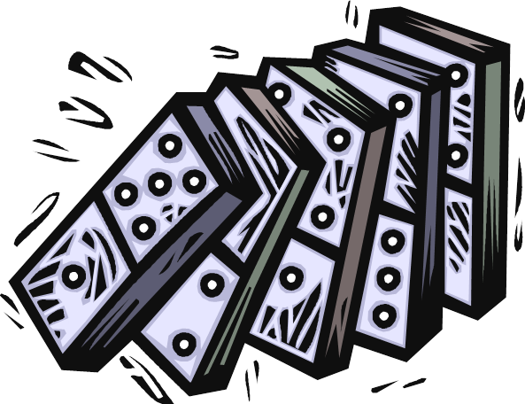
Essay: Cause and Effect

Slide 2
IDEA #1 SUPPORTING DETAILS
INTRODUCTION
IDEA 1
CONCLUSION
IDEA #2 SUPPORTING DETAILS
IDEA 2
IDEA 3
IDEA #3 SUPPORTING DETAILS

Slide 3
Sometimes, a writer will want to explain how one event leads to another
This kind of text structure is called cause and effect

Slide 4
Example 1
Thesis: Not getting enough sleep leads students to forget assignments, make poor choices on exams, and not listen during lectures.
Cause – Not getting enough sleep
Effects - forget assignments, make poor choices on exams, not listen during lectures

Slide 5
Example 2
Poor grades in college are usually caused by lack of sleep, poor time management, and low motivation levels.
Thesis: To succeed in school, students need to avoid the pitfalls suffered by many college freshmen. Poor grades in college are usually caused by lack of sleep, poor time management, and low motivation levels.

Slide 6
Cause and Effect Signal Words
When authors write paragraphs to show causes and effects, they use words like cause, effect, as a result, consequently, and so

Slide 7
More Signal Words
Cause Effect
Because As a result
The reason for Outcome
On account of Finally
Bring about Consequently
Give rise to Therefore
Created by For this reason
Contributed by Hence
Led to Effect
Due to Then
Since So

Slide 8
Writing a cause and effect essay:
STEPS

Slide 9
1. Distinguish between cause and effect.
To determine causes, ask, "Why did this happen?"
To identify effects, ask, "What happened because of this?“

Slide 10
2. Develop your thesis statement.
State clearly whether you are discussing causes, effects, or both.
Introduce your main idea, using the terms “cause” and/or “effect.”

Slide 11
3. Organise supporting details.
You can organise details in the following ways:
• Chronological. Details are arranged in the order in which the events occurred.
• Order of importance. Details are arranged from least to most important or vice versa.
• Categorical. Details are arranged by dividing the topic into parts or categories.

Slide 12
4. Use appropriate transitions.
To blend details,
use the transitional
words and phrases.
Effect Signal Words | Cause Signal Words
consequently, as a result, thus, resulted in, one result is, another is, therefore | because, due to, one cause is, another is, since, for, first, second

Slide 13
Organization Patterns
Focus must be only on one topic and its causes/effects
Unity is achieved in a paragraph by deciding on an organizational pattern.
Is there a link between the causes or effects? Use that link as the controlling idea (ex. negative effects, positive outcomes, happy reasons.)

Slide 14
Cause Focus - writing only about causes
Introduction paragraph (discuss effects as hook)
Body Paragraph 1: Cause One
Body Paragraph 2: Cause Two
Body Paragraph 3: Cause Three
Conclusion
Effect Focus – writing only about effects
Introduction paragraph (discuss causes as hook)
Body Paragraph 1: Effect One
Body Paragraph 2: Effect Two
Body Paragraph 3: Effect Three
Conclusion

Slide 15
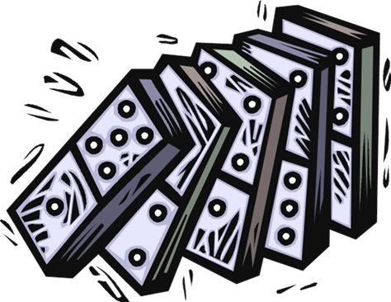
Chain Reaction - used for closely linked causes/effects.
Introduction
Cause/Effect Body Paragraphs (one link or many links in each paragraph)
Conclusion

Slide 16
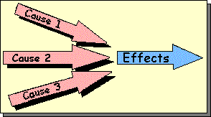
Multiple Causes-->Effect
In this pattern, the organization is as follows:
Thesis statement: Air pollution is caused by a variety of imperceptible, but controllable industries.
I. exhaust gases from cars
A. government does not take enough control
B. citizens are not as conscientious as they could be
II. uncontrolled factory gases
A. no regular checks on gases released that need to be regulated
B. factories are inside the borders of residential areas and should be moved
III. burning of low-quality coal for heating
A. government does not take enough control
B. other forms of energy are too expensive, but

Slide 17
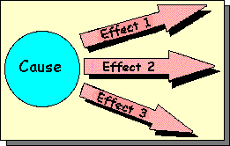
Cause-->Multiple Effects
In this pattern, the effects of a certain situation are
explained in separate paragraphs, with the following
organization:
Thesis statement: Watching too much TV is one of the major sociological issues of this century, which has many effects on the physiology and psychology of people.
I. eating disorders
A. TV meals
B. obesity
II. communication problems
A. more violence
B. no interpersonal talk

Slide 18
Causal Chain / Domino
In this pattern, the events lead to one another, as in the following organization:
Thesis statement: Using deodorants with chlorofluorocarbon gas will bring the end of world.
I. Chlorofluorocarbon gases are contained in most deodorants and released by some factories into the air.
II. This gas causes the ozone layer to become thinner and finally disappear in patches.
III. The unfiltered ultraviolet rays of the sun cause overheating in the poles of the earth, where the icebergs start to melt.
IV. The huge amount of water released from the poles leads to a rise in the sea-level.
V. The sea will cover the land and this will be the end of the world.

Slide 19
Cause-Effect Essay
Introduction
Introduce the subject
Body
Describe the cause and its effects
cause
effect
effect
effect
Conclusion
Summary

Slide 20
Choose one of the following topics and write a cause and effect essay:
- What are causes of weight gain? - Why do women, despite their frequent denials, love macho men? - Why is it preferable (or silly) to marry someone of your own ethnicity or religion? - Why is soccer, the world’s most popular sport ? - How does smoking marijuana affect your mental or physical health? - Why does flattery work, even when the person being flattered knows you are a lying liar?

